Slide 1
Guided Capstone
Tee Chulikavit

Slide 2
Big Mountain Resort
Background
Installed an additional chair lift, increasing operations costs by $1.54 million
Ticket Pricing strategy based on market averages
  Unable to compare vitality of other competitors
Factors in Question
Operational Costs
  Cuts to costs may be suitable to offset the additional chair lift
Revamped Pricing Strategy
  Elevated strategy that simply takes market averages into account, rather than being the main factor,
  Needs to focus more on the attributes of the resort itself.

Slide 3
Provided Constraints
Data Sources
Pricing (ours and competitors’)
Popularity (ours and competitors’)
Operational Costs
Streams of Revenue
Stakeholders:
Jimmy Blackburn - Director of Operations
Alesha Eisen - Database Manager
Challenges:
Missing data, inaccurate understandings of competitors’ pricing strategy, and various other unknown variables

Slide 4
Recommendations and Findings
Cost Cutting
“It only takes one mistake”
Cutting operational costs can risk the safety of our patrons and result in consequences that far outweigh the benefits of cost-cuts, including publicity, lawsuits, and injuries.
Pricing Strategy
“The resort's pricing strategy has been to charge a premium above the average price of resorts in its market segment.”
We found examples of how this strategy has been counter-intuitive. The strategy to be proposed will be elevated and comprehensive of all factors and attributes of our facilities.

Slide 5
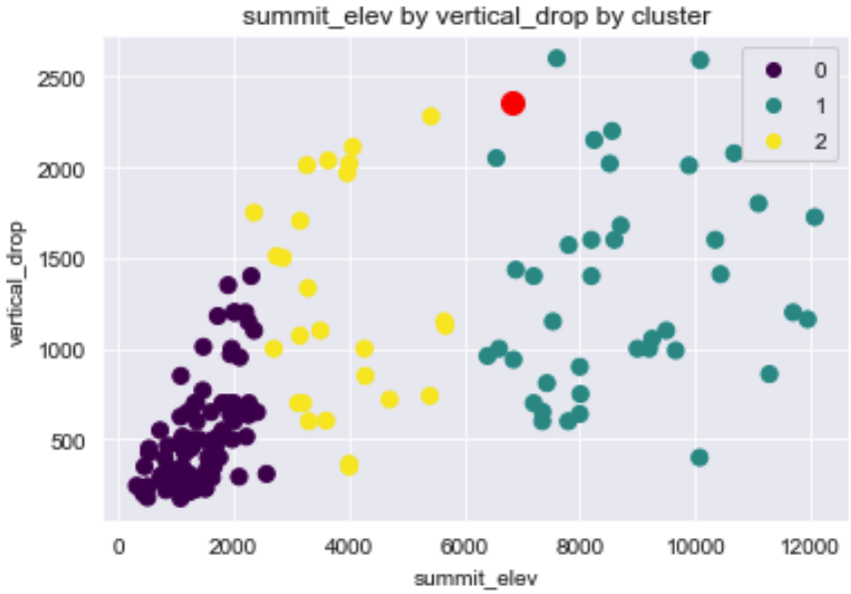
Findings
Evaluated the data of Big Mountain Resort and other resorts based on scope of skiable area.
K-Clustering machine learning model to find optimal number of clusters
  Cluster 1 (purple): <3,000 summit elevation
  Cluster 2 (yellow): 2,000-6,000 summit elevation
  Cluster 3 (green): >6,000 summit elevation
Big Mountain Resort is associated with Cluster 3
Stands out from other resorts with a high summit elevation and an extensive vertical drop

Slide 6
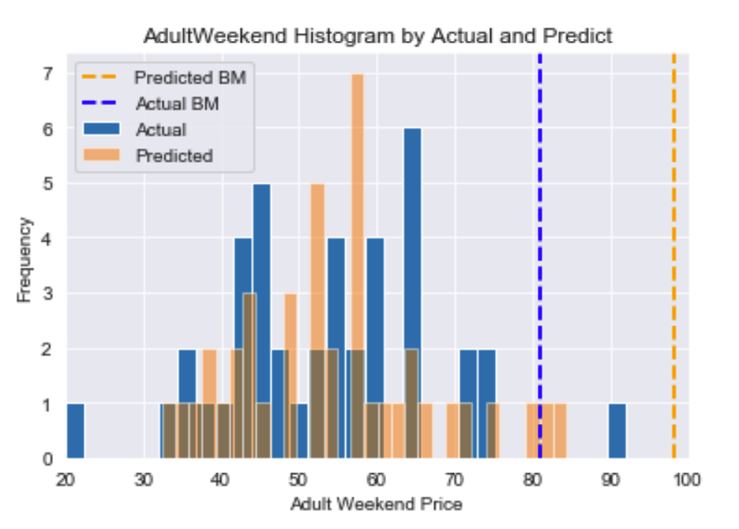
Findings
Applied Linear Regression and compared prices for Adults on the weekends to the predicted price by the modeling.
Big Mountain currently offers a price for adults on weekends of $81
With Big Mountain’s facilities, the model predicted the same facilities at $98
This shows a $17 increase per adult on the weekend, a 20% price increase justified by the unique factors of Big Mountain Resort’s facilities.

Slide 7
Findings
K-Clustering allowed more visibility into how Big Mountain Resort has a wider variety and larger scope of skiable areas.
This shows a more diverse experience open to numerous levels snow sports through a larger spectrum of facilities available at Big Mountain Resort exclusively.
Linear Regression allowed for a machine learning model to objectively factor in the data from our own and our own competitors’ resorts in order to what our prices ought to be.
This leads into the pricing strategy that is not only based on the market averages of our competitors at face-value, but their prices with their attributes factored in, as well as our own.

Slide 8
Summary
Through machine learning, we found two flaws in our pricing strategy:
  We are comparing only prices, not prices based on attributes
  Big Mountain Resort can offer a wider variety of skiable area that others cannot
Applying the machine learning model to one aspect of our ticket prices (the price of one adult on the weekend) show we are able to justify an 20% increase in ticket prices
This can be applied to all different price points of all ages of all days across all of our competitors in order to create a pricing strategy.
This elevated pricing strategy will be multi-dimensional and can be applied to all of our prices in order to offset, not only the additional operational costs of another chair lift, but will bring Big Mountain Resort simply at a standard for what we offer.

